Slide 1




A Post-Pandemic Machine Learning-Based Method for Forecasting Safe-Haven Asset Prices
Gold Prices
Cai Yuxin
Dao Duy Hung
Li Tieming
Luo Lisheng
(Circa SMU December 2022)

Slide 2





Agenda
01
02
03
04
05
Motivation
Data
Methodology
Results
Discussion and limitation

Slide 3
Motivation
To build better understanding on how pandemic events would affect safe-haven assets
Why during onset of pandemic, equity markets fell as much as 30% while Gold appreciated 12.85%
Create up-to-date models to forecast safe-haven asset prices
Provide investors with better market insights
Secure hedge on equity investments/provide better total return on investments
Research insight could be an Alternative Investment Solution for Investors
Provide Long-Only Fund Managers a solution to capture alpha with Gold ETF during equity market rout.

Slide 4
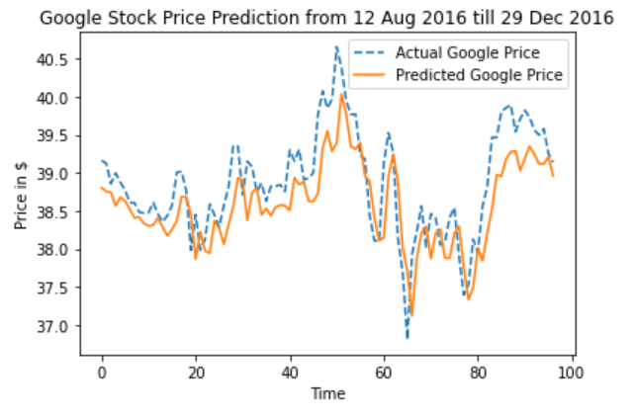
Short review of class content（LSTM）
The predicted results have a high correlation with the actual values of the previous day
We need more features to alleviate this problem!

Slide 5
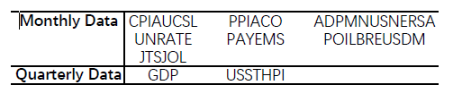
Data Source
Federal Reserve Bank of St. Louis, Bloomberg, "Yahoo! Finance", list of data features can be found Appendix A.
Data period | From first Jan 2013 to 30th Nov 2022, 10 years of data
Daily Data Monthly & Quarterly Data New Covid cases Doge Coin data | We join the daily data together, dropping the NaN values and keeping a date that both have data records. For monthly and quarterly data, the government usually publishes these data at the end of the period. Therefore the actual date of these data is different from the date of publication. Some economic movements or price fluctuations were affected after the data were released. Therefore, the dates of the data are based on the time of publication. Replace the NaN values with 0.

Slide 6
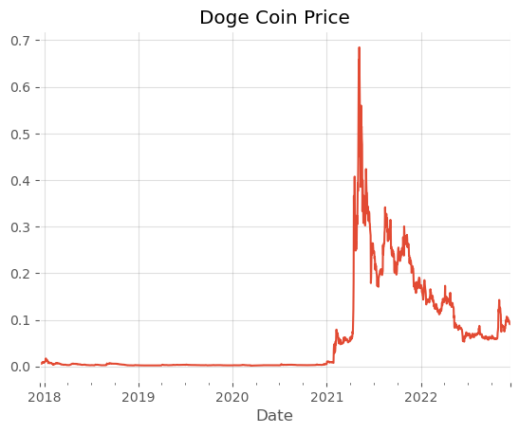
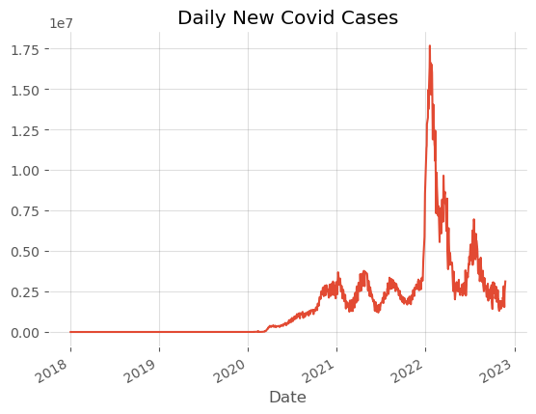
Data
What we want to know is whether the economic significance is related to the sharp trend.

Slide 7
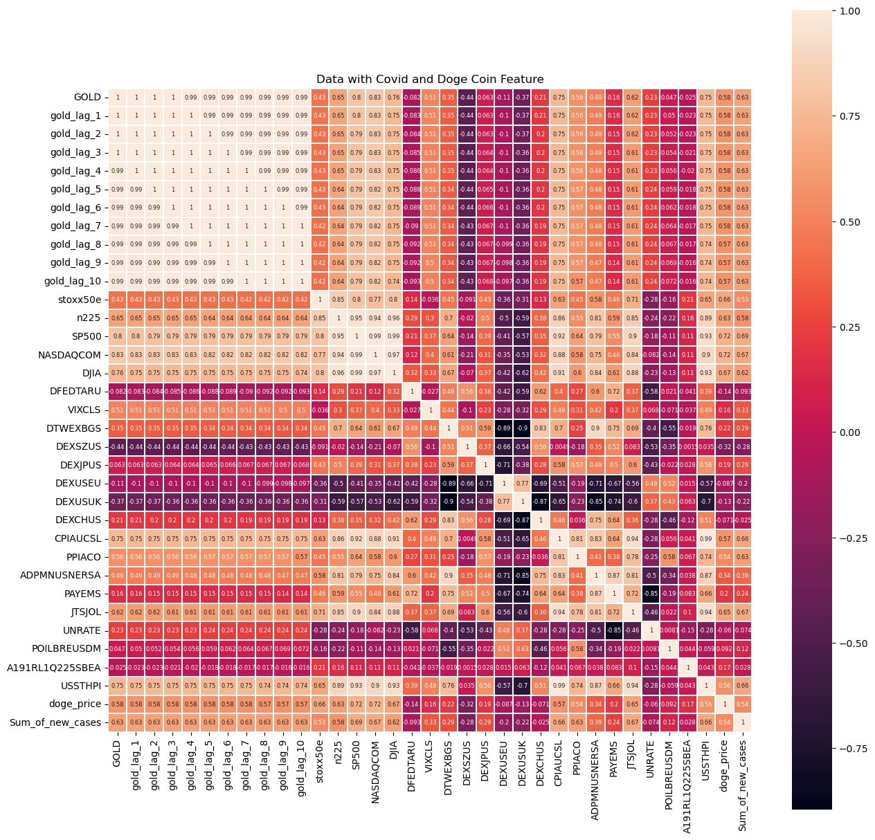
Data Correlation Heatmap

Slide 8
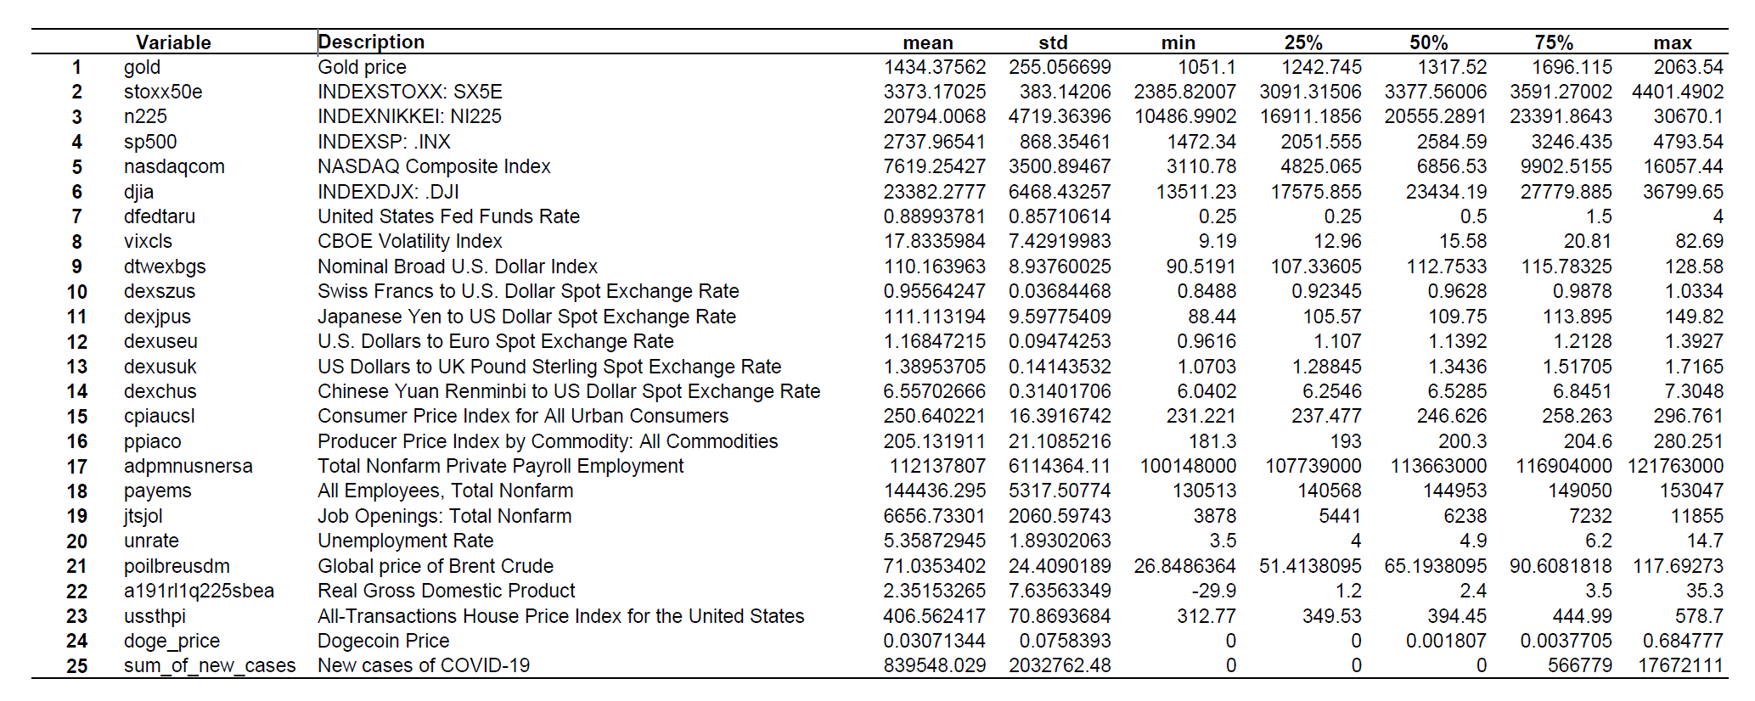
Data Description

Slide 9
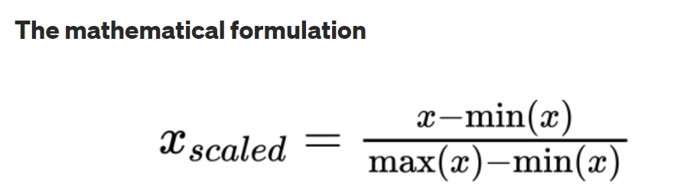
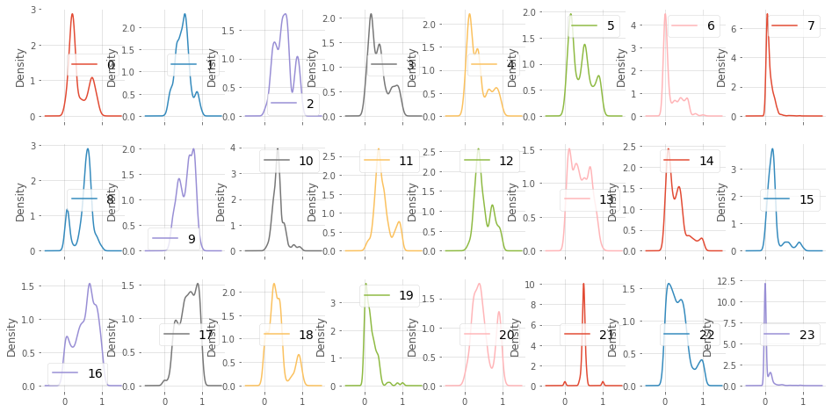
Min-Max Normalization
Min-max normalization (usually called feature scaling) performs a linear transformation on the original data. This technique gets all the scaled data in the range
(0, 1). The formula to achieve this is the following:
Min-max normalization preserves the relationships among the original data values. The cost of having this bounded range is that we will end up with smaller standard deviations, which can suppress the effect of outliers.

Slide 10
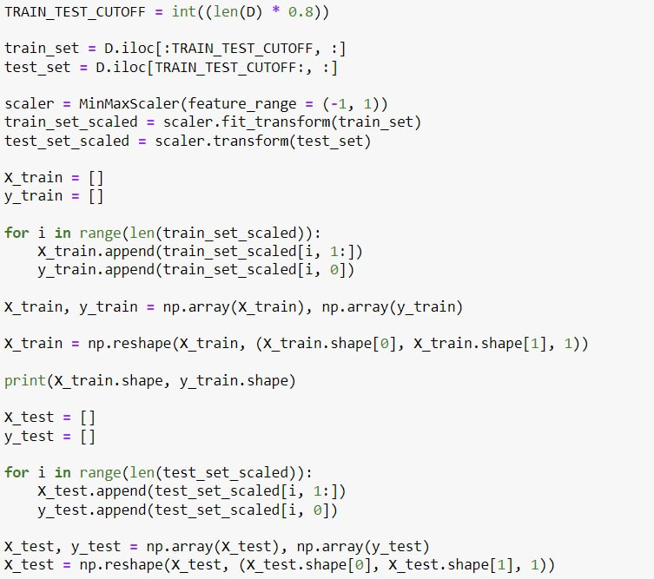
Training & Testing
The normalized mean and standard deviation of the test data are calculated on the training data
Scaling the overall data set to an interval in the same proportion
Key points:
Ensure that the training set contains sufficient amount of COVID-19 data.

Slide 11
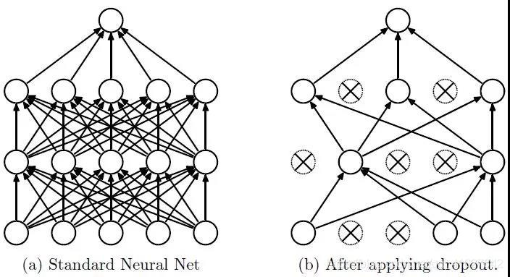
Regularization Dropout
Dropout can deactivate some of the nodes and can serve to simplify the structure of the neural network.
Dropout can make the model more generalizable because it does not depend too much on certain features.

Slide 12
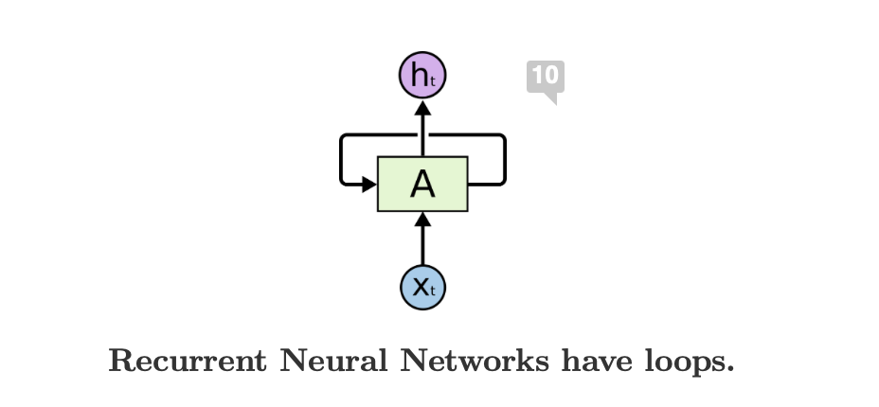

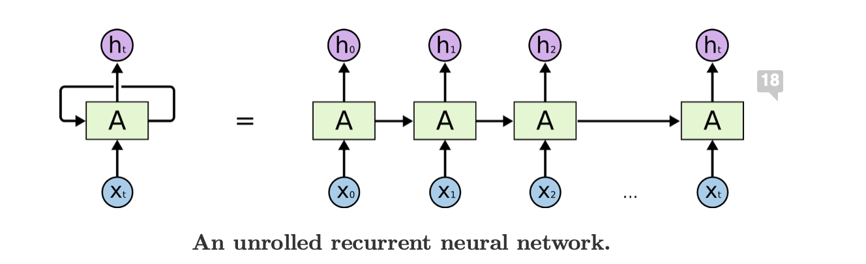

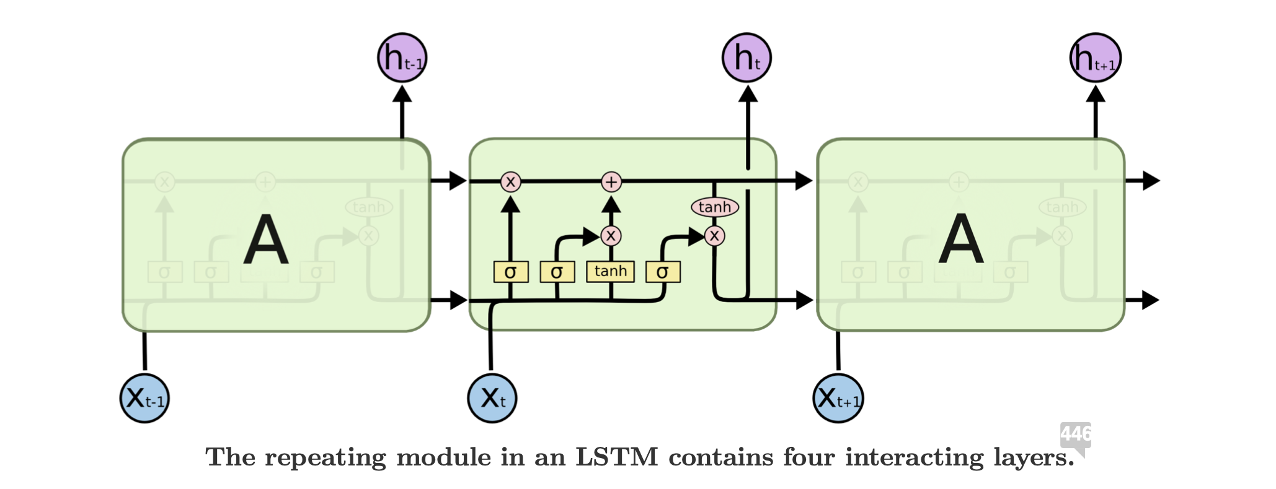

Methodology – LSTM
Convolutional Neural Networks
CNN used to recognize a series of multiple objects without requiring explicit segmentation from of the object from their own surrounding environment (LeCun et al., 1999).
Recurrent Neural Networks
Recurrent neural network use feedback loop that help to process the sequence of data and pattern to give the prediction. It allows information to persist.
Long-short term memory
Long Short-Term Memory networks – usually just called “LSTMs” – are a special kind of RNN, capable of learning long-term dependencies.

Slide 13
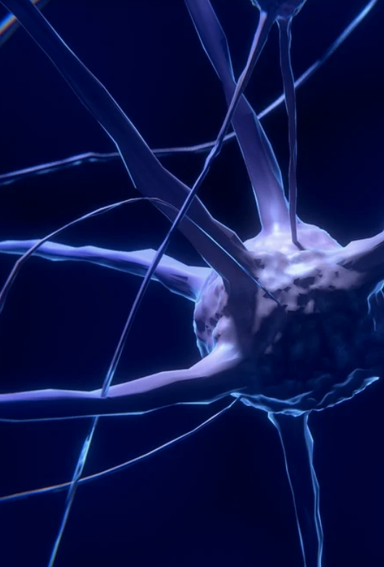





Methodology – LSTM
Objective
Predictions
Gates
The essential objective for LSTM neural networks is to model long term dependencies for time series problems
LSTM is a RNN network that is trained using back diffusion through time and overcoming the issue of vanishing gradient (Graves et al., 2013).
Long Short-Term Memory (LSTM) provides a memory for the contribution of previous time series which can further enhance the predictions for future values.
LSTM has been proven to produce more accurate prediction result
than traditional statistical methods when it comes to modeling time series data. (Hochreiter and Schmidhuber 1997).
The forget gate, based on certain conditions, decides which information to eliminate from the block
The input gate which conditionally selects what information from input to update the memory state .
Finally, the output gate that conditionally decides the output base on the memories and input information of the block (Hochreiter and Schmidhuber 1997).

Slide 14
Methodology – LSTM-CNN
Convolutional Neural Networks (CNN) has shown to well suited for this task and will be one of the methods to be incorporated in our research.
The convolutional layers for extracting useful information and learning the internal representation of time-series data with LSTM layers for identify short-term and long-term dependencies.
Utilization of LSTM layers along with additional convolutional layers could provide a significant boost in predicting performance.

Slide 15
Methodology LSTM- CNN
Model Config
def LSTM_CNN():
model = Sequential()
model.add(LSTM(units=u,return_sequences=True, input_shape = (X_train.shape[1], 1)))
model.add(Dropout(0.2))
model.add(LSTM(units=u,return_sequences=True))
model.add(Dropout(0.2))
model.add(LSTM(units=u,return_sequences=True))
model.add(Dropout(0.2))
model.add(Conv1D(filters = 10, kernel_size = 5, padding = 'same', input_shape = (X_train.shape[1], 1)))
model.add(LSTM(units=u))
model.add(Dropout(0.2))
model.add(Dense(units=1))
return model
model = CNN_LSTM()
model.compile(optimizer="adam", loss="mae", metrics=["mse"])
model.summary()
model.fit(X_train, y_train, epochs = ep, batch_size = 10, verbose=v)
predict_train = model.predict(X_train, batch_size=10, verbose=v)

Slide 16




Methodology – Bidirectional LSTM
Process of making any neural network have the sequence information in both directions backwards (future to past) or forward(past to future).
Two LSTM memory blocks on one layer. One block receive forwarded sequence information. One receive reversed sequence information
Bidirectional-LSTM- based modeling offers better predictions than regular LSTM- based models.
Better model performance on sequence classification problem

Slide 17
Methodology – Bidirectional LSTM
Model Config
def biLSTM(u):
model = Sequential()
model.add(Bidirectional(LSTM(units = u, return_sequences = True), input_shape = (X_train.shape[1], 1)))
model.add(Dropout(0.2))
model.add(Bidirectional(LSTM(units = u, return_sequences = True)))
model.add(Dropout(0.2))
model.add(Bidirectional(LSTM(units = u, return_sequences = True)))
model.add(Dropout(0.2))
model.add(Bidirectional(LSTM(units = u)))
model.add(Dense(units = 1))
return model
model = biLSTM(u)
model.compile(optimizer="adam", loss="mae", metrics=["mse"])
model.summary()
model.fit(X_train, y_train, epochs = ep, batch_size = 10, verbose=v)
predict_train = model.predict(X_train, batch_size=10, verbose=v)

Slide 18




Methodology – Decision Tree
Previous Data
Predictor Space
Decisions tree is a method for categorization or prediction by using previous data where individual answers will be incorporated to the larger question
Break down predictor space into simpler regions which summaraized into trees and lead to more choices (Njoku, 2019)
Non-Parametric
Opportunity
They are non parametric and can model without prior assumption
Help with decisions making, solving problems and reveal potential opportunity

Slide 19


Methodology – Random Forest
Classifying
Fixed
Random Forest tries to fit several classifying decision tree then use averaging to improve the prediction accuracy and from overfitting (Marwala & Leke, 2019)
Random forest fixed all of these problems as the tree in random forest is running on parallel, and there are no interactions while the building the tree (low bias and high variance). Thus, averaging benefited them
Decisions Tree
Developing
Decisions tree has high risk of being overfitting, computationally expensive to train and tend to find local optima because they cannot go back after they have been split (Liu & Li, 2016)
Random Forest consist of developing a “forest” of decision trees created from a randomized algorithm. Different random forest regression differs by their randomness noise perturbation to the induction procedure

Slide 20
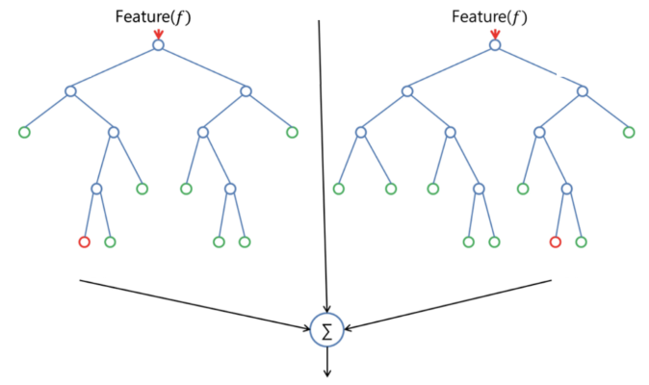



Methodology – Random Forest
Important Features
According to Dan Liu and Zhi Li who used random forest to predict the gold price concluded DJIA, and S&P 500 are the only two must be included features
Random Forest is a powerful method to predicting the gold price (Liu & Li, 2016)
The number of factors should be considered wisely as the more factors included, the more difficult to included more data (Liu & Li, 2016)

Slide 21




Methodology – Gradient Boosting
What?
Why?
New Method
Drawbacks
Gradient Boosting is a scalable tree machine learning algorithm that uses gradient descent method in function space (Chen & Guestrin, 2016).
It capable for fitting nonparametric models, more successful when fitting decision tree models
XG Boost is a new and effective gradient boosting model developed in recent years
Drawbacks when it comes to tuning due to the substantial number of parameters and required expert knowledge compared to other methods.

Slide 22







Methodology XG-BOOST
Performance
State-of-the-art
Why?
In a Kaggle competition in 2015, out of the 29 winning solutions, 17 solutions used XG Boost (Chen & Guestrin, 2016)
The XG Boost performed well because the machine learning models gave stronger forecasts the shorter the prediction interval (Chen & Guestrin, 2016)
The key for XG Boost success is in its scalability and adaptability to every scenario. This is because of the algorithmic optimization, and scales to billions of examples in a limited memory setting.

Slide 23




Methodology XG-BOOST
Research
Good Results
Advantages
In their research, XG Boost has the lowest RMSE and MAE while higher R-squared when it comes to forecasting gold price. This show XG Boost provide the best result when it comes to time series data.
Jabeur, Mefteha and Viviani in “Forecasting gold price with the XGBoost algorithm and SHAP interaction” values paper stated the empirical superiority of XG Boost compared to 6 other models
The combination of decision trees and gradient boosting methods has shown to have advantages for good training effect and difficult to be overfitted

Slide 24
Methodology XG Boost
Model Config
def build_model(seed):
X_train = []
y_train = []
for i in range(len(train_set_scaled)):
X_train.append(train_set_scaled[i, 1:])
y_train.append(train_set_scaled[i, 0])
X_train, y_train = np.array(X_train), np.array(y_train)
XGBoost_params={'max_depth':25,
'learning_rate':0.03,
'subsample':0.8,
'eval_metric':'rmse',
'seed': seed
}
XGB=XGBRegressor(**XGBoost_params)
XGB.fit(X_train,y_train)

Slide 25
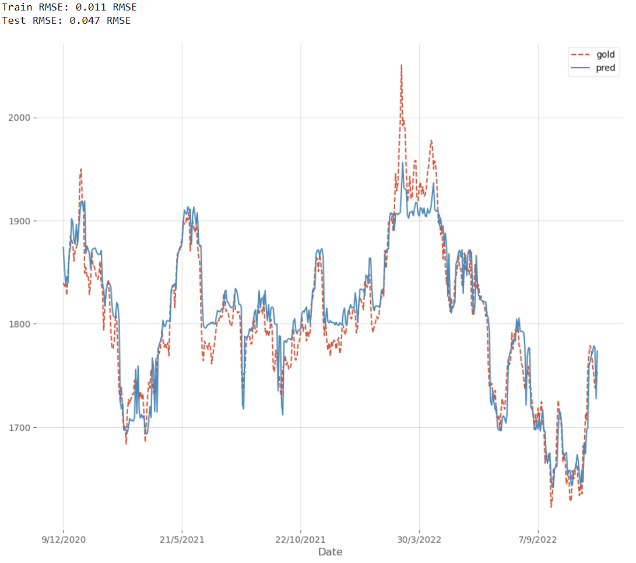
Random Forest Without COVID-19

Slide 26
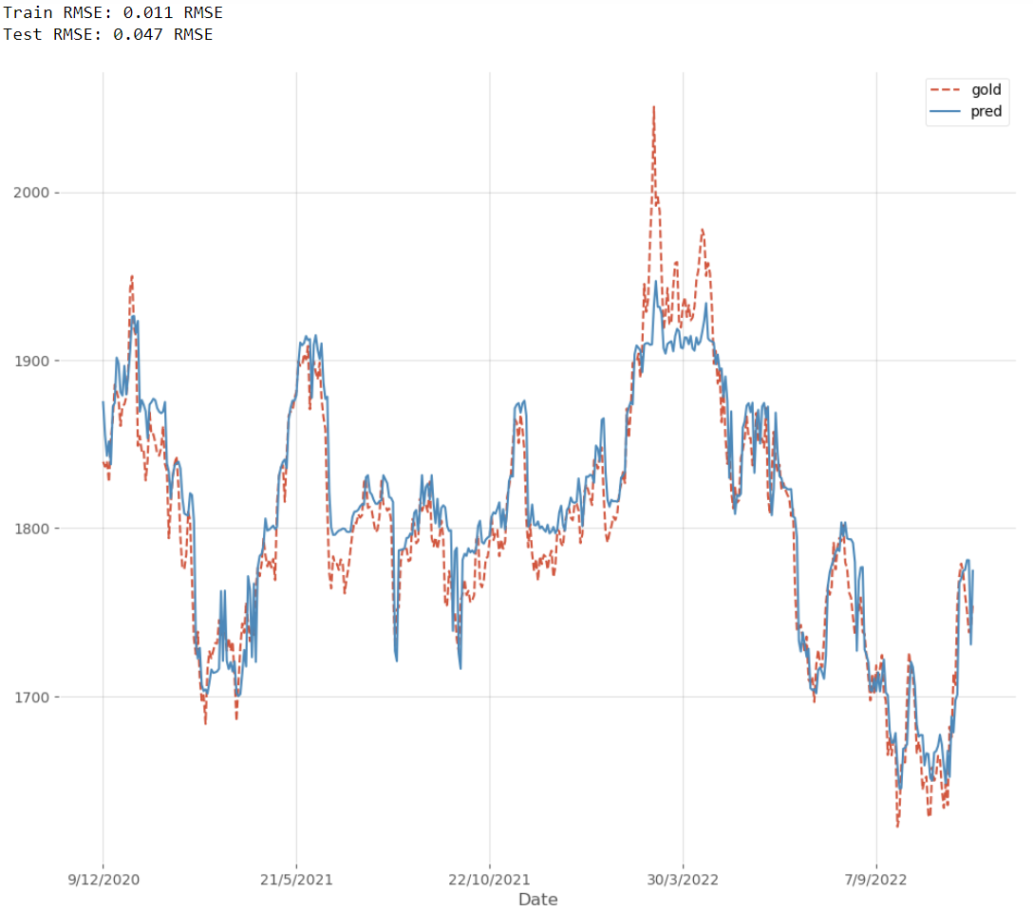
Random Forest With COVID-19

Slide 27
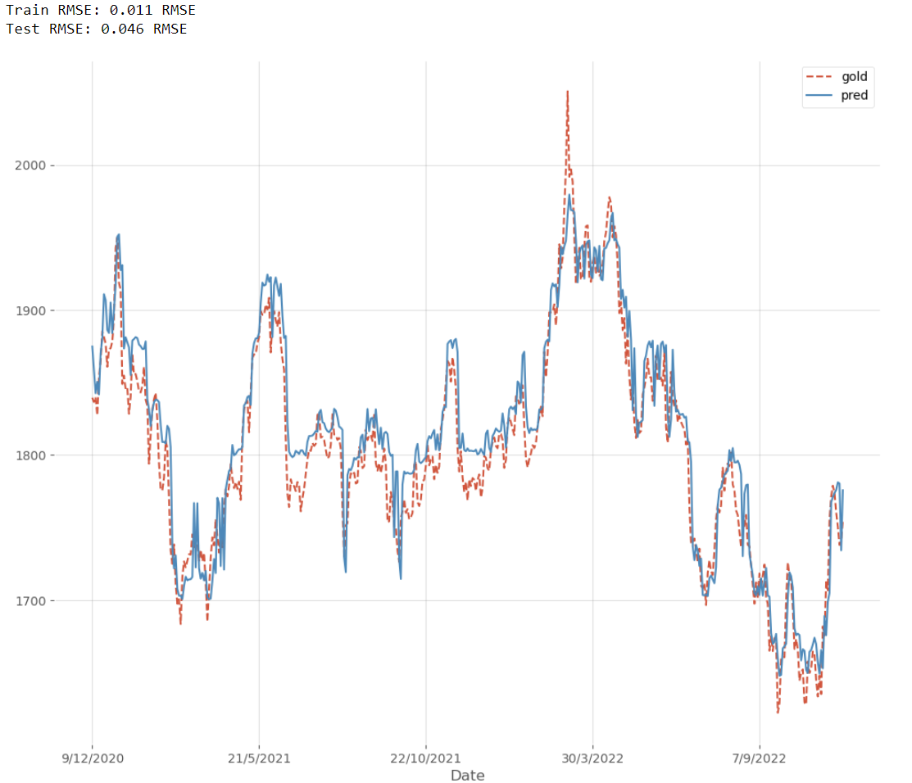
Random Forest With COVID-19 and Doge

Slide 28
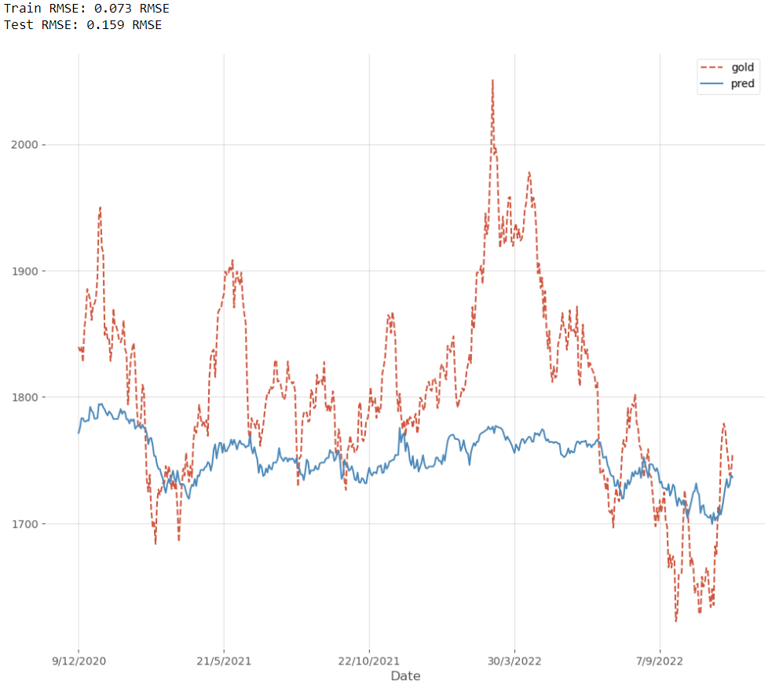
Random Forest Summary
Without COVID
With COVID
With COVID and Competitor
Train RMSE:
0.011
0.011
0.011
Test RMSE:
0.047
0.047
0.046
Feature Impt:
-
0.003249
0.004948
Train and Test RMSE are highly consistent
Model performing significantly better in training than in testing set suggesting overfitting
Reduce max_depth, n_estimators, and/or max_samples to overcome overfitting
Feature importance increased instead of decrease with competitor
Increased feature importance strengthens economic significance
Train RMSE:
0.073
Test RMSE:
0.159

Slide 29
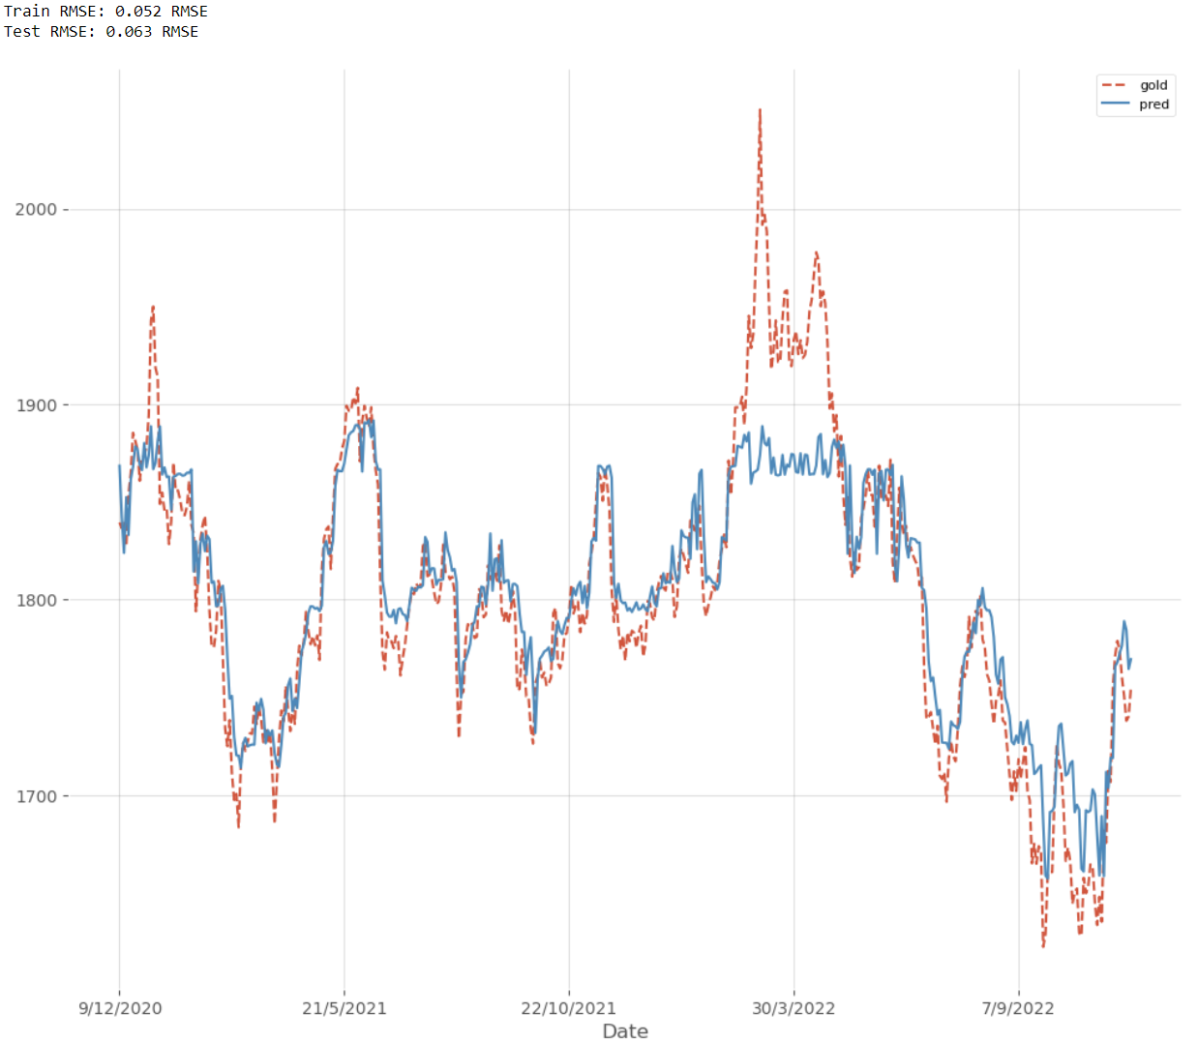
XGBoost Without COVID-19

Slide 30
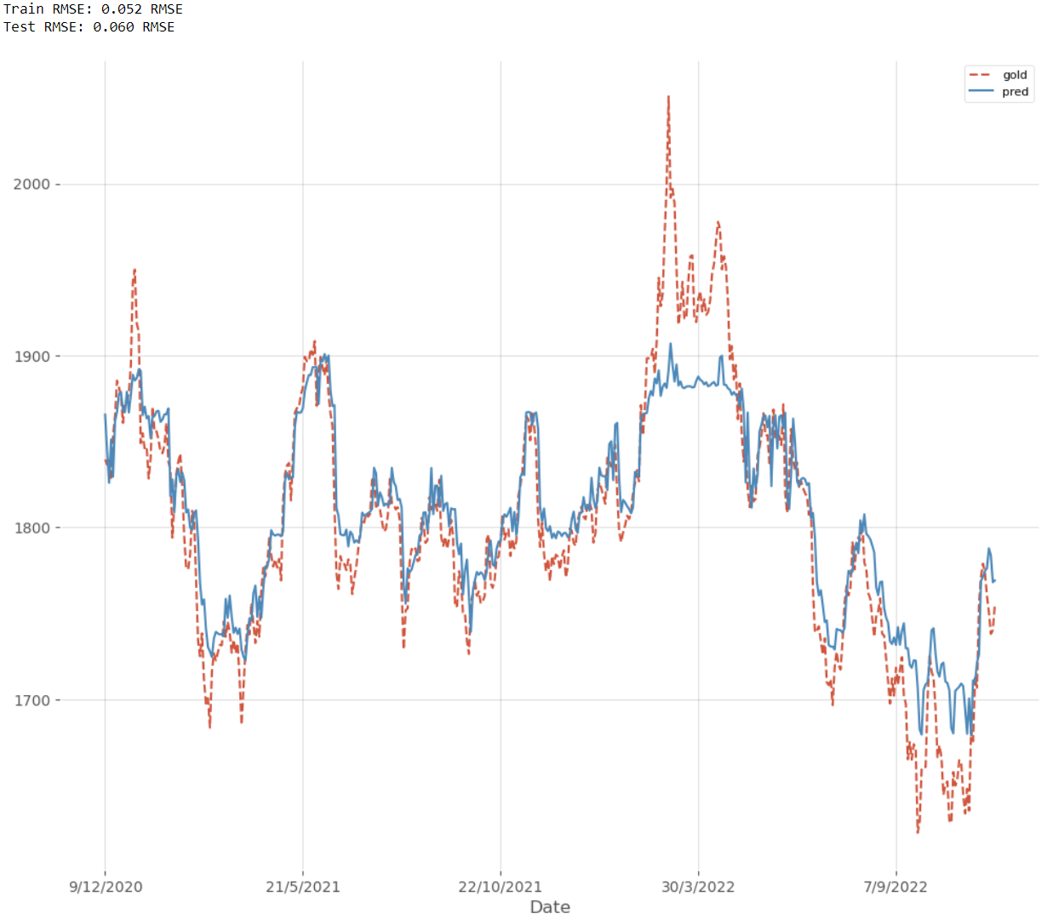
XGBoost With COVID-19

Slide 31
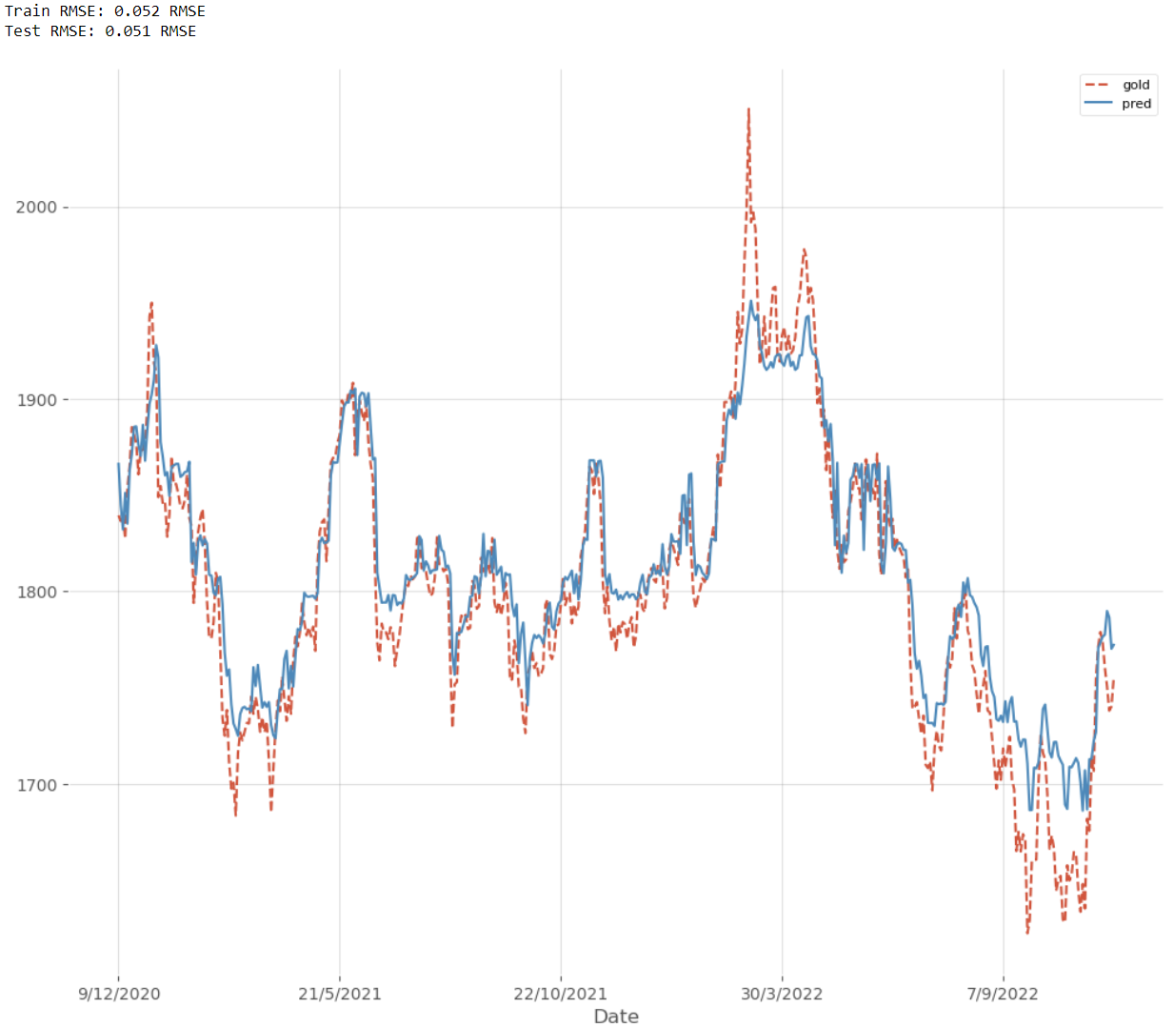
XGBoost With COVID-19 and Doge

Slide 32
XGBoost Summary
Without COVID
With COVID
With COVID and Competitor
Train RMSE:
0.052
0.052
0.052
Test RMSE:
0.063
0.060
0.051
Feature Impt:
-
0.1102
0.11005
Train RMSE are remained constant, whereas test RMSE varies
Test performance is better with COVID and competitor dataset
Performance increases as more variables are added
Feature importance decreased slightly with competitor
Decreased feature importance erodes economic significance

Slide 33
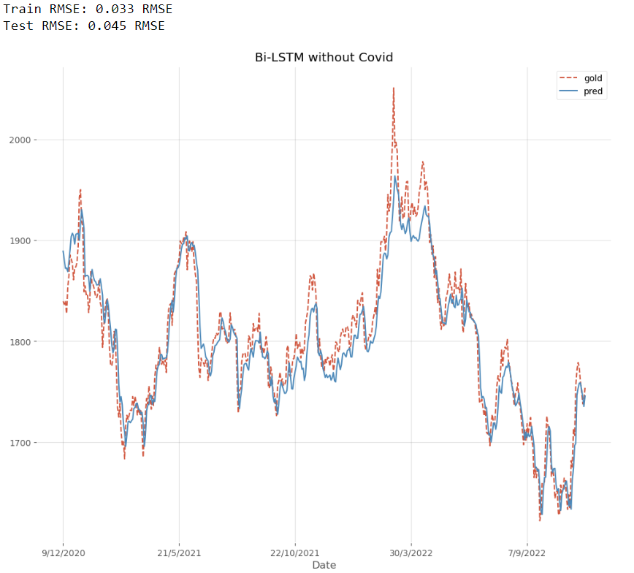
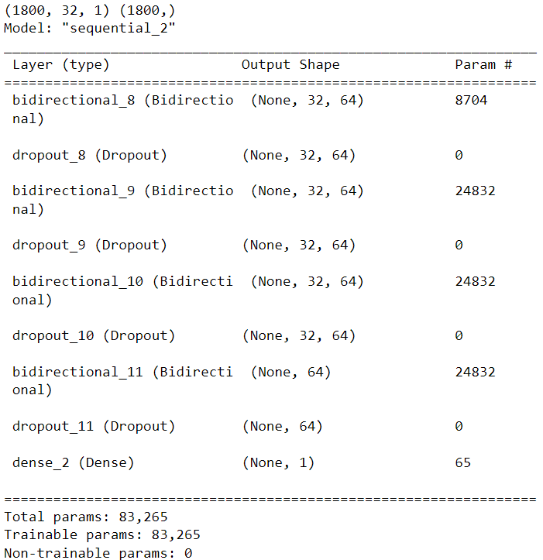
Bi-LSTM Without COVID
Model Summary
(1st layer) No. of Params = 8 * [(32 * (32+1)) + (1*32)] = 8794
(3rd layer) No. of Params = 8 * [(32 * (32+1)) + (64*32)] = 24832

Slide 34
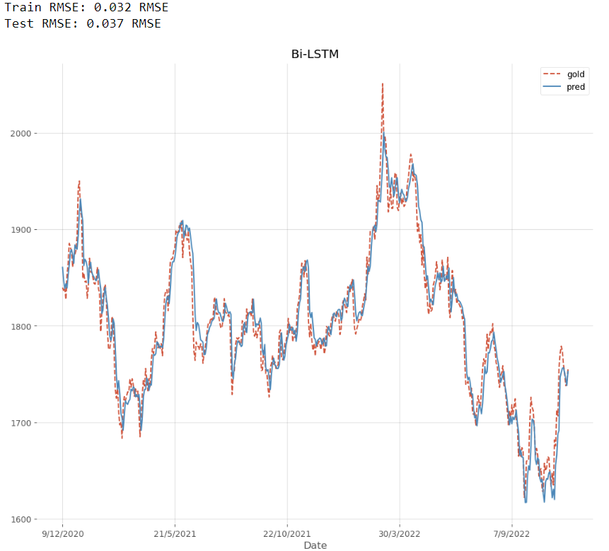
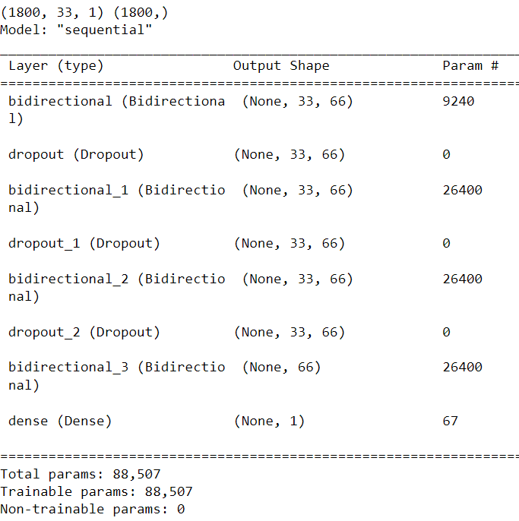
Bi-LSTM With COVID
Model Summary

Slide 35

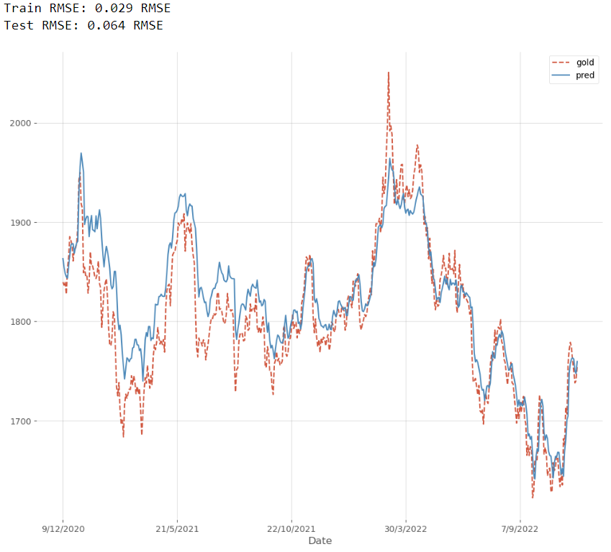
Bi-LSTM With COVID and Doge
Model Summary

Slide 36
Bi-LSTM Summary
Without COVID
With COVID
With COVID and Competitor
Train RMSE:
0.033
0.032
0.029
Test RMSE:
0.045
0.037
0.064
SHAP value:
-
1.1277e-07
2.5196e-07
Train RMSEs are decreased marginally for every added variable
Test RMSE is largest in dataset with COVID and Competitor
Test performance is best on dataset with COVID
More variables does not guarantee better performance
SHAP value increased with competitor
SHAP value increase justifies economic significance
**SHapley Additive exPlanation (SHAP) value – using game theory to explain feature importance

Slide 37
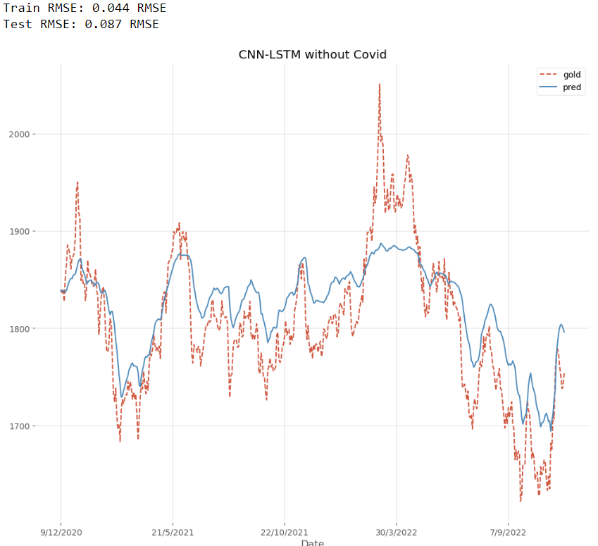
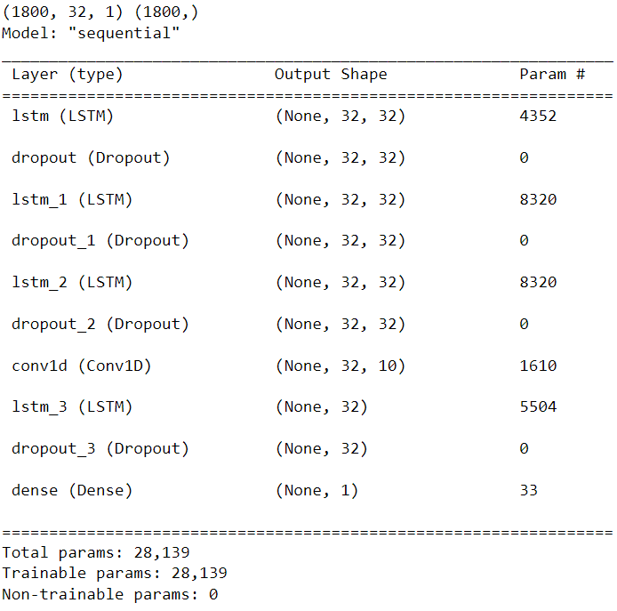
LSTM-CNN Without COVID
Model Summary

Slide 38
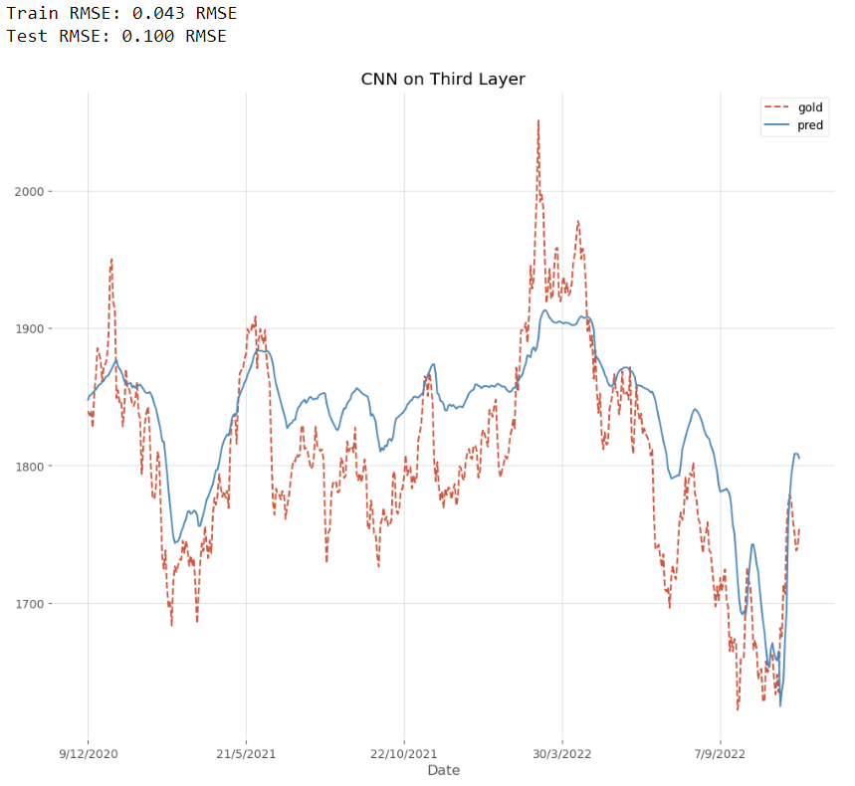
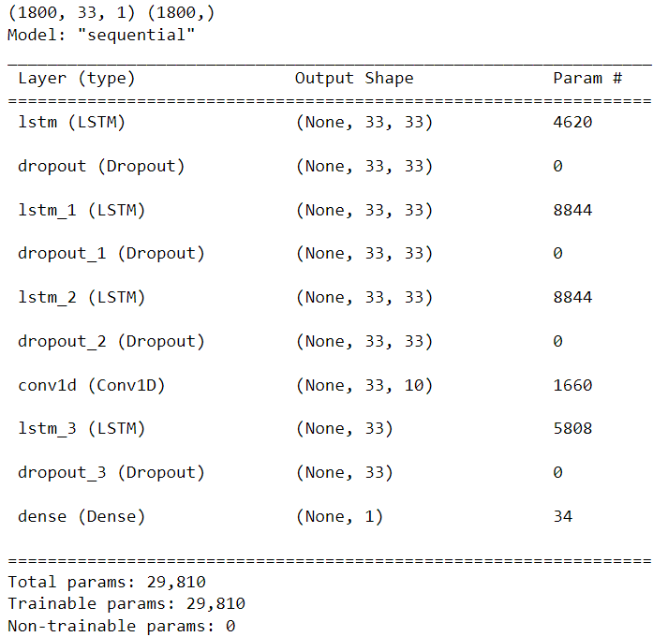
LSTM-CNN With COVID
Model Summary

Slide 39
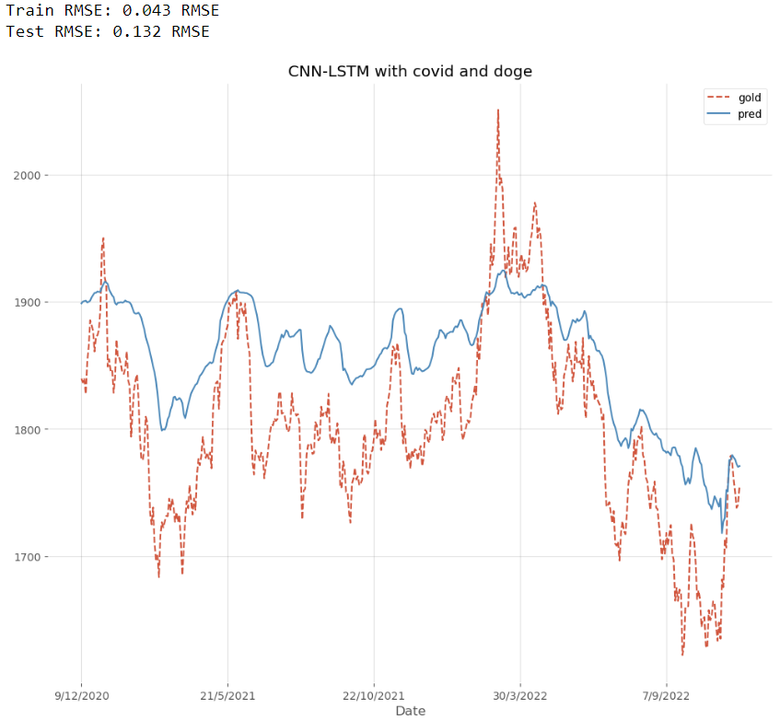
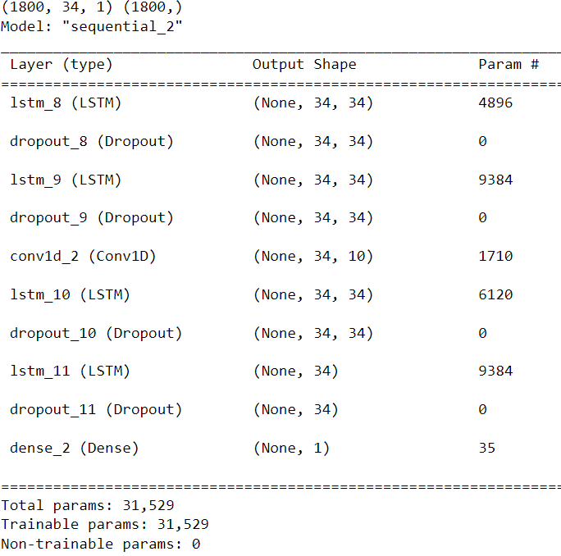
LSTM-CNN With COVID and Doge
Model Summary

Slide 40
LSTM-CNN Summary
Without COVID
With COVID
With COVID and Competitor
Train RMSE:
0.044
0.043
0.043
Test RMSE:
0.087
0.100
0.132
SHAP value:
-
-2.17402e-09
1.30207e-08
Train RMSEs are relatively constant at c.0.043
Test performance is best using data without COVID
Performance decreased as more variables are added
SHAP value increased to positive when competitor is added
Negative SHAP value is contradicting and suggests negative impact on gold price prediction
Pure LSTM’s SHAP movement was also downwards from positive to negative
This suggests LSTM in itself is not a good fit (RMSE: 0.115 & 0.167)(covid & covid with doge)

Slide 41
Results Comparison
Data With Covid (Methods) | Test RMSE
Random Forest | 0.047
XGBoost | 0.060
Bi-LSTM | 0.037
LSTM-CNN | 0.100

Slide 42
Discussion
Conclusion
Majority of the models show an increase in feature importance of covid when competitor is added
This supports the idea of having an updated post-pandemic model for forecasting asset prices
Bi-LSTM model performed the best for this research
Limitation
No direct, explicit way of getting feature importance for neural network models
Machine/computing memory limitation (e.g. 5hrs to run one Bi-LSTM batch size, epoch, neurons hyperparameter tuning)
Future Research
Explore testing variables like commercial or political variables on gold prices
Use more optimization methods

Slide 43
Citations
Artigas, J. C. (2020, February 14). Potential impact of the coronavirus on gold. Gold.com. Retrieved December 9, 2022, from https://www.gold.org/goldhub/gold-focus/2020/02/potential-impact-coronavirus-gold
Baldwin R. The greater trade collapse of 2020: learnings from the 2008–2009 great trade collapse. 2020. https://voxeu.org/article/greater-trade-collapse-2020.
Banerjee, A. K. (2021). Futures market and the contagion effect of covid-19 syndrome. Finance Research Letters, 43, 102. https://doi.org/10.1016/j.frl.2021.102018
Chen, T., & Guestrin, C. (2016). XGBoost. Proceedings of the 22nd ACM SIGKDD International Conference on Knowledge Discovery and Data Mining, 785–794. https://doi.org/10.1145/2939672.2939785
Clements, K. W., & Fry, R. (2008). Commodity currencies and currency commodities. Resources Policy, 33(2), 55–73. https://doi.org/10.1016/j.resourpol.2007.10.004
Colvin, C., & McLaughlin , E. (2022, September 13). Coronavirus and Spanish flu: Economic lessons to learn from the last truly global pandemic. The Conversation. Retrieved December 9, 2022, from https://theconversation.com/coronavirus-and-spanish-flu-economic-lessons-to-learn-from-the-last-truly-global-pandemic-133176
Dan Liu, Zhi Li. Gold Price Forecasting and Related Influence Factors Analysis Based on Random Forest. DOI:10.1007/978-981-10-1837-4_59
Esparcia, C., Jareño, F., & Umar, Z. (2022). Revisiting the safe haven role of gold across time and frequencies during the covid-19 pandemic. The North American Journal of Economics and Finance, 61, 101677. https://doi.org/10.1016/j.najef.2022.101677
Goldstein, I., Koijen, R. S., & Mueller, H. M. (2021). Covid-19 and its impact on financial markets and the real economy. The Review of Financial Studies, 34(11), 5135–5148. https://doi.org/10.1093/rfs/hhab085

Slide 44
Citations
Gormsen NJ, Koijen RS. Coronavirus: impact on stock prices and growth expectations. Rev Asset Pric Stud. 2020;10(4):574–97. https://doi.org/10.1093/rapstu/raaa013.
Graves, A., Jaitly, N., & Mohamed, A.-rahman. (2013). Hybrid speech recognition with Deep Bidirectional LSTM. 2013 IEEE Workshop on Automatic Speech Recognition and Understanding, 273–278. https://doi.org/10.1109/asru.2013.6707742
Hochreiter, S., & Schmidhuber, J. (1997). Long short-term memory. Neural Computation, 9(8), 1735–1780. https://doi.org/10.1162/neco.1997.9.8.1735
Hoffman, K., & Motta, G. (2021, September 27). Covid-19's impact on the Global Gold Industry: Implications for the next normal and beyond. McKinsey & Company. Retrieved December 9, 2022, from https://www.mckinsey.com/industries/metals-and-mining/our-insights/covid-19s-impact-on-the-global-gold-industry-implications-for-the-next-normal-and-beyond
Ibrahim Yousef, Esam Shehadeh. The Impact of COVID-19 on Gold Price Volatility. DOI:10.35808/ijeba/592
IE, Pintelas E, Pintelas P. A LSTM-CNN model for gold price time-series forecasting. Neural Comput Appl. 2020;32(23): 1–10. A LSTM-CNN model for gold price time-series forecasting | SpringerLink
Jabeur, S. B., Mefteh-Wali, S., & Viviani, J.-L. (2021). Forecasting gold price with the XGBOOST algorithm and Shap Interaction values. Annals of Operations Research. https://doi.org/10.1007/s10479-021-04187-w
Jordà Ò, S. S. (2020). Longer-run economic consequences of pandemics. National Bureau of Economic Research.

Slide 45
Citations
Khani MM, Vahidnia S, Abbasi A. A Deep Learning-Based Method for Forecasting Gold Price with Respect to Pandemics. DOI:10.1007/s42979-021-00724-3
Lawrence, C. (2003) Why Is Gold Different from Other Assets? An Empirical Investigation. Vol. 6, the World Gold Council, 1.
Leach, M., MacGregor, H., Scoones, I., & Wilkinson, A. (2021). Post-pandemic transformations: How and why covid-19 requires us to rethink development. World Development, 138, 105233. https://doi.org/10.1016/j.worlddev.2020.105233
LeCun, Y., Haffner, P., Bottou, L., & Bengio, Y. (1999). Object recognition with gradient-based learning. Shape, Contour and Grouping in Computer Vision, 1681, 319–345. https://doi.org/10.1007/3-540-46805-6_19
Liu, D., & Li, Z. (2016). Gold price forecasting and related influence factors analysis based on random forest. Advances in Intelligent Systems and Computing, 711–723. https://doi.org/10.1007/978-981-10-1837-4_59
Lizardo, R. A., & Mollick, A. V. (2010). Oil price fluctuations and U.S. dollar exchange rates. Energy Economics, 32(2), 399–408. https://doi.org/10.1016/j.eneco.2009.10.005
Marwala, T., & Leke, C. A. (2019). Decision trees and random forests. Handbook of Machine Learning, 2, 199–214. https://doi.org/10.1142/9789811205675_0011
Mefteh-Wali S, Ben Jabeur S. Viviani JL. Forecasting gold price with the XGBoost algorithm and SHAP interaction values. DOI:10.1007/s10479-021-04187-w
Mohtasham Khani, M., Vahidnia, S., & Abbasi, A. (2021). A deep learning-based method for forecasting gold price with respect to pandemics. SN Computer Science, 2(4). https://doi.org/10.1007/s42979-021-00724-3

Slide 46
Citations
Njoku, O. C. (2019). Decision Trees and Their Application for Classifification and Regression Problems (thesis). MSU Graduate Theses, Missouri.
Pukthuanthong, K., & Roll, R. (2011). Gold and the dollar (and the euro, pound, and yen). Journal of Banking & Finance, 35(8), 2070–2083. https://doi.org/10.1016/j.jbankfin.2011.01.014
Reuters. (2021, October 28). Gold demand fell in the third quarter as Big Investors sold, says WGC. Reuters. Retrieved December 9, 2022, from https://www.reuters.com/business/gold-demand-fell-third-quarter-big-investors-sold-says-wgc-2021-10-28/
Sappor, J. S., Yu, A., Nickels, L., & Cecil, R. (2021, June 24). Impact of covid-19 pandemic on Industrial Metals Markets - one year on. Impact of COVID-19 pandemic on industrial metals markets - one year on | S&P Global Market Intelligence. Retrieved December 9, 2022, from https://www.spglobal.com/marketintelligence/en/news-insights/research/impact-of-covid-19-pandemic-on-industrial-metals-markets-one-year-on
Sieroń, A. (2020, March 14). Pandemics and gold: Part 1. Yahoo! Finance. Retrieved December 9, 2022, from https://finance.yahoo.com/news/pandemics-gold-part-1-164031733.html

Slide 47
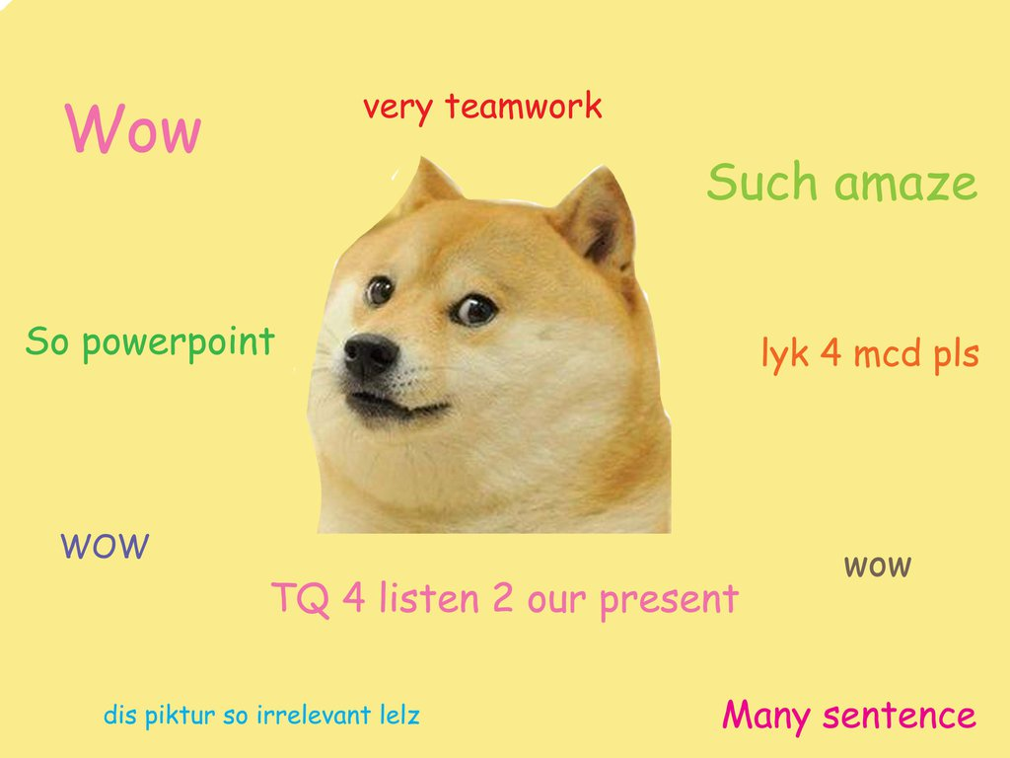
Thank You For Lishenging!

